Slide 1
How to Accurately
Weigh and Measure Children
for the CHDP Well-Child Exam
Adapted by the State of California CHDP Nutrition Subcommittee
from the online training module:
“Accurately Weighing & Measuring Infants,
Children and Adolescents: Technique”
U.S. Department of Health and Human Services
Health Resources and Services Administration
Maternal and Child Health Bureau
http://depts.washington.edu/growth/
Revised April 2021
Notes:
Talking Points:
The work you do is very important because you are critical in determining the health status of a child. Today we’re going to talk about a job that you’re very familiar with, weighing and measuring children. This is a routine job that can be very difficult especially when the office is busy or chaotic.
When you do a job over and over throughout the day, especially under time constraints, it is often natural to stop paying attention to your technique as you fall into a routine. The purpose of this training is to help you focus back on the details so you can keep your technique sharp.

Slide 2
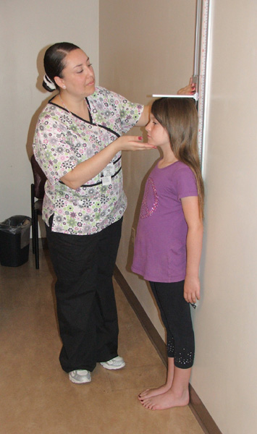
Objectives
By the end of this presentation
you will be able to:
Accurately weigh a child
Accurately measure a child
Manage common problems encountered
Notes:
Speaker Tips:
Describe contents of training.

Slide 3
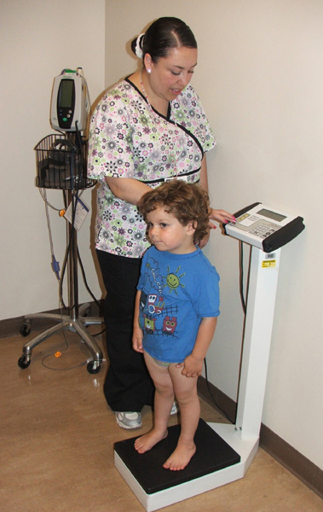
Measurements You Take
Are Important
Height, length, and weight alert providers to:
Growth problems
Feeding problems
Emotional or social problems
Illness
Notes:
Talking Points:
Growth provides a window into a child’s life
Most of the time the results of weighing and measuring reflect a normal growth pattern
A deviation in the growth pattern can indicate conditions such growth problems ,feeding problems, emotional or social problem at home or illness.

Slide 4
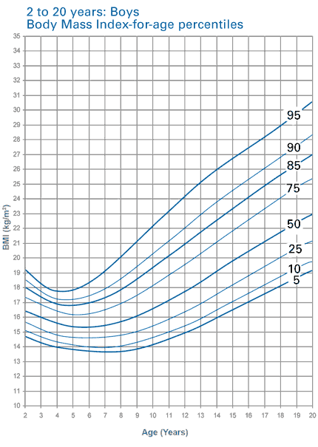
Accurate Measuring Is Critical
BMI for 5 year old boy
Weight: 43.5 lb
Height: 43.0 in
BMI = 16.5
BMI-for-age =
75-84th percentile
Normal range
If height is inaccurate:
Weight: 43.5 lb
Height: 42.5 in
BMI = 17.0
BMI-for-age =
85-94th percentile
Overweight range
Notes:
Talking Points:
Measurements must be obtained and recorded accurately if they are to be used as an effective screening tool. Use recommended procedures for measuring stature and weight.
To illustrate the importance of accurate data, we use the case of a 5-year-old boy, whose height was inaccurately measured as shorter than he actually is. Notice that when the BMI is calculated and plotted, the measurement error of 0.5 inch in height results in a movement upward on the growth curve. This child, who is truly between the 75th - 84th percentile, and should be classified as ‘normal weight’, will be plotted on the 85th - 94th percentile, and classified as ‘overweight’. You can see here how errors in measurement can cause errors in interpretation.
You can see from this example that it is desirable to have a series of accurate measurements to monitor growth trends. Having a series of measurements takes into consideration short- and longer-term conditions.
A sudden change in the consistency of the growth pattern may alert you to errors in obtaining, recording or plotting measurements. If a child’s growth deviates from an expected pattern, is below the 5th percentile, between the 84th and 94th, and at or above the 95th percentile, recheck your work even if it means repeating the weight and height measurement, calculations and plotting. When you’ve confirmed your work, then you can make an accurate determination of the weight category and provide appropriate follow up and referrals.

Slide 5
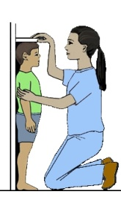
Your Measurements
Guide Providers
In-depth
Medical
Assessment
Take and Plot
Measurements
Weight
Height
Age
BMI
Obese
Overweight
Abnormal
BMI %
Growth
Chart
Lab Tests
(cholesterol &
glucose)
Normal*
Underweight
Normal
*Further tests may be warranted depending on family history
Note in chart:
“Counsel & Follow-up”
Notes:
Talking Points:
As you can see, taking height and weight measurements is the first step in a long process.
This slide summarizes each step in the assessment process leading to the determination of the necessity for lab tests.
Emphasize why accurate measurements and plotting manually /digitally are important tools in the screening process and subsequent prevention or treatment.

Slide 6

Your Measurements
Guide Many Others
HeadStart
WIC
Your
Measurements
Weight
Height
Age
BMI
Schools
BMI %
Growth
Chart
Parents
Notes:
Talking Points:
Many different people depend and rely on the weights and heights taken in a provider's office, so it's important to carefully and accurately
measure:
WIC computers automatically classify children based on your measurements.
School nurses refer students and plan programs based on your measurements.
Parents and children modify feeding and physical activity behaviors based on your measurements.
All these groups depend on the measurements that come from your office.

Slide 7
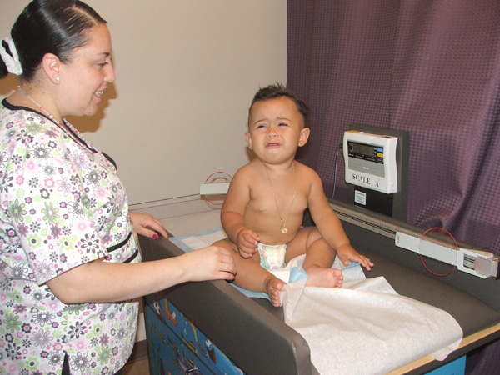
What challenges
do you face?
How do you handle them?
Notes:
Background Information:
This is an important sharing time with your audience.
Use this information to individualize your training.
Tips for successful weighing and measuring:
Ask parent/caregiver to assist and reassure
Infants:
Do head circumference first. Ask parent to hold baby in arms; restrain baby's arms gently if needed.
Second, weigh baby.
Third, measure. Have parent assist by holding head and shoulders and talking to baby.
Older toddlers and children:
Demonstrate weighing and measuring with older sibling, stuffed toy or doll.
Ask child to hold arms by side or across tummy when standing on scale.
If fearful of stadiometer, get down to child's level. Distract by asking child look at you, or toy or poster across the room.
Common Challenges
How do you handle:
1) Uncooperative child (screams, cries, jumps, moves), 2) wet/dirty diaper, 3) child is sleeping, 4) pony tail or hairstyle, 5) extra clothin
What are your tricks to cooperation?

Slide 8

Respect Privacy
Use a private area or exam room for the following:
Removal of clothing and
donning gown
Taking measurements
Discussing results
Notes:
Talking points:
It’s important to respect the privacy of your patients, as height and weight are sensitive issues
Your clinic should have a clear procedures for assuring privacy

Slide 9
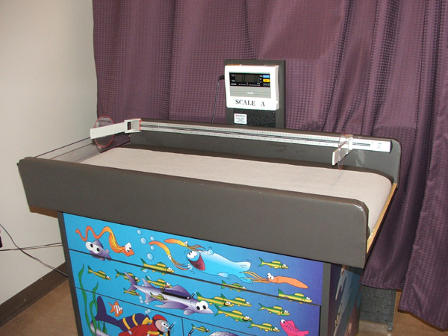
Before you begin:
Determine equipment needed for infant and child
Make sure equipment is clean, safe, and in good condition
Using a balance scale? Set to zero
Using a digital scale? Press the zero key to zero the indicator
Notes:
Background Information:
Infants and children require different equipment
CHDP can provide information about equipment standards.
Equipment must be calibrated yearly according to HRSA* guidelines. Your equipment must have proof of calibration on the equipment.
*HRSA (Health Resources and Services Administration) is part of the U.S. Dept of Health and Human Services and helps provide health resources for medically underserved populations.

Slide 10
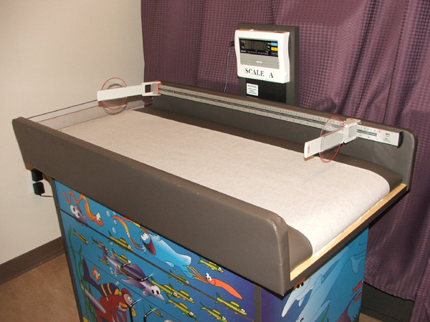
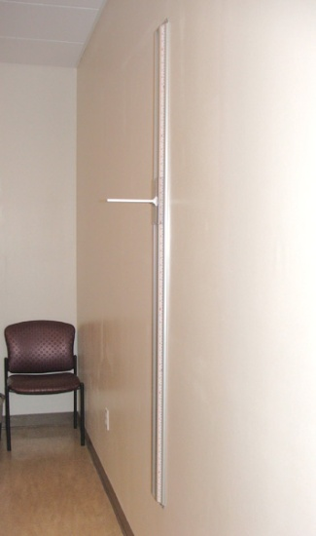
Measure Lying or Standing?
Length (Lying)
Use Birth – 24 months
WHO growth chart
Unable to stand
without assistance*
Stature (Standing)
Able to stand without
assistance
Use 2 – 20 years
CDC growth chart
Notes:
*If a child is 2 years and older and cannot stand to measure - use recumbent length, then adjust the length to be a stature measurement by subtracting 0.8 cm. This can be plotted on the CDC Growth charts 2 – 20 including BMI-for-age. As the child ages their growth can be tracked and this solution will work for even older children. CDC WHO growth chart training states 0.8 cm(1/4 inch).

Slide 11
Measuring Infant’s Length
Equipment Needed:
Measuring board
Movable foot piece
Rigid headboard
Marked to 1/8”
Need assistant

Slide 12
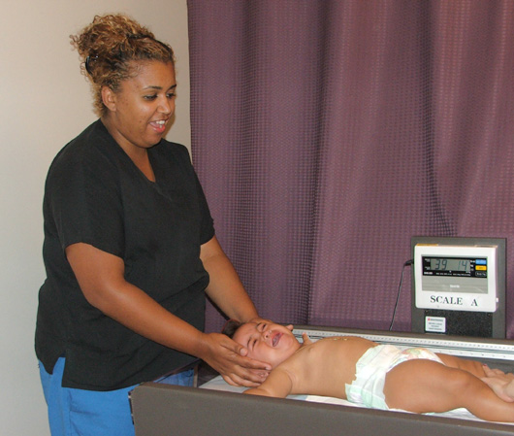
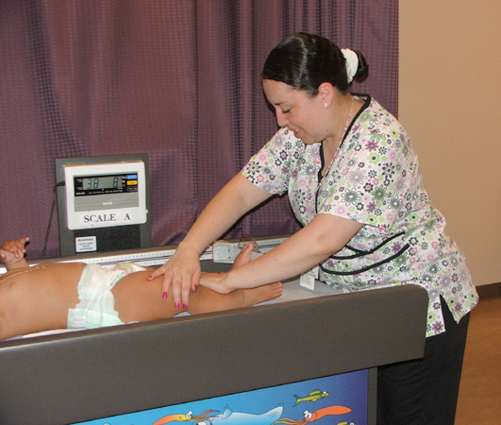
Measuring Infant’s Length
Notes:
Talking Points:
Here are some tips to successfully measure an infant:
Measure infant wearing only clean, dry diaper. No shoes.
Lay infant on her back.
Assistant or parent holds head firmly against headboard.
With one hand, hold infant knees down, straightening the hips and knees
With the other hand, move the footboard until it is resting firmly against infant heels. Toes point directly up.
Measure length to nearest 1/8”
Record measurement right away.

Slide 13
Inappropriate
Methods of Measuring
Measuring tape or yardstick attached to tabletops
Measuring between 2 pencil marks on exam table
Notes:
Talking Points:
**Inappropriate methods lead to inaccurate measurements

Slide 14
Measuring Infant’s Length
Measure infant wearing only clean, dry diaper. No shoes.
Lay infant on back.
Assistant or parent holds
head firmly against the headboard.
With one hand, hold infant knees down, straightening the hips and knees.

Slide 15
Measuring Infant’s Length
With the other hand,
move the footboard
until it is resting firmly
against infant heels.
Toes point directly up.
Measure length to nearest 1/8”.

Slide 16
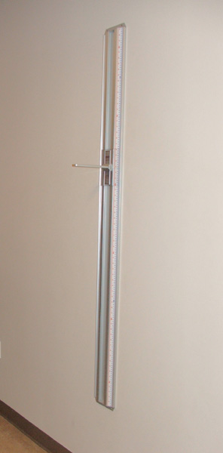
Measuring Height (Stature)
Equipment Needed:
Vertical stadiometer (height rod):
  Movable horizontal
  headboard
  Marked to 1/8”
  Attached to a firm,
  vertical surface
  (without baseboard)

Slide 17
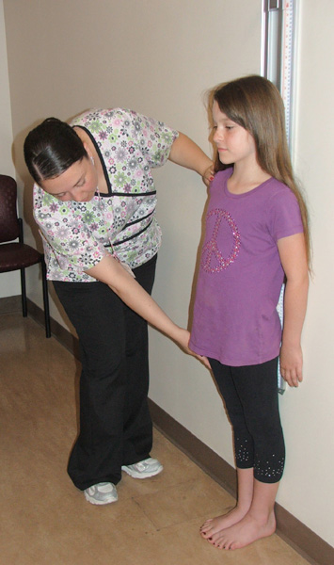
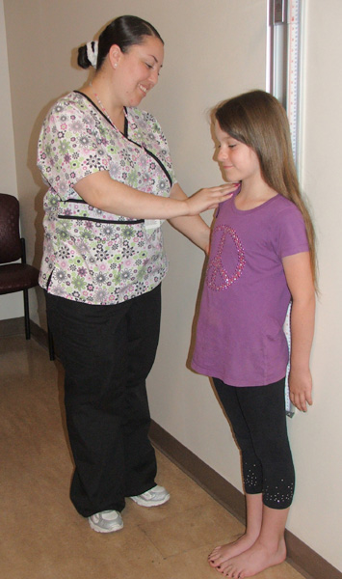
Measuring Height (Stature)
Notes:
Talking Points:
Remove shoes and outer clothing (jackets, hats). Shoes can add as much as 1” to the height.
Child stands on a bare, flat surface with heels slightly apart; back as straight as possible.
Heels, buttocks, head and shoulders blades touch the wall or measuring surface.
Eyes should be straight ahead, arms at side, and shoulders relaxed.
Ask child to stand as tall as possible, keeping heels on the ground.
Slowly lower headboard until it touches the crown of the head firmly.
Check the child’s position. Measurer’s eyes are parallel with the headpiece.
Measure length to the nearest 1/8”.
Record measurement right away.

Slide 18
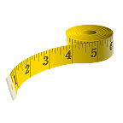
Inappropriate
Methods of Measuring
Measuring tapes
Yardstick or poster attached to wall
Height rod attached to scale
Notes:
Talking Points:
**Inappropriate methods lead to inaccurate measurements

Slide 19
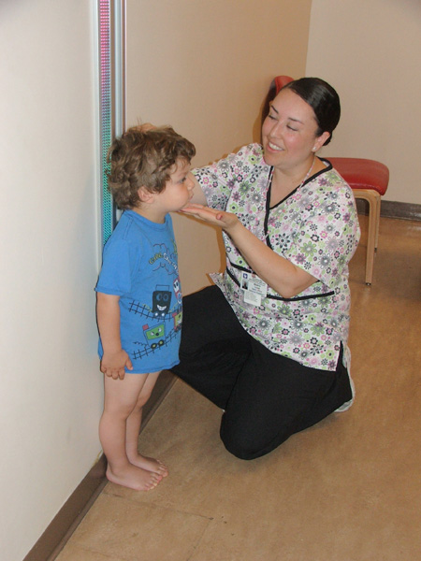
Measuring Height (Stature)
Remove shoes and outer clothing
(jackets, hats).
Child stands on a bare, flat surface with heels slightly apart; back as straight as possible.
Heels, buttocks, head and shoulders blades touch the
wall or measuring surface.
Eyes should be straight
ahead, arms at side,
and shoulders relaxed.
Notes:
Shoes can add as much as 1” to the height.

Slide 20
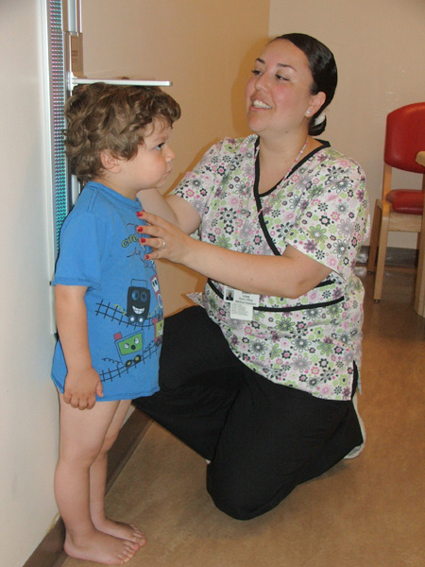
Measuring Height (Stature)
Ask child to stand as tall as possible, keeping heels on the ground.
Slowly lower headboard until it touches the crown of the head firmly.
Check the child’s position. Measurer’s eyes are parallel with the headpiece.
Measure height to the nearest 1/8”.

Slide 21
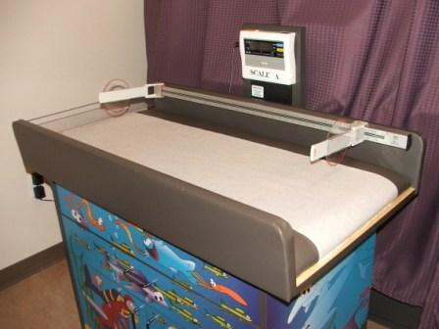
Weighing Infants & Toddlers
Equipment needed:
  Beam balance or
  electronic scale
  At least 35 lb capacity
  Weigh in 10 g or ½ oz increments
  Large tray to fully support infant
  Can be easily “zeroed” and calibrated

Slide 22
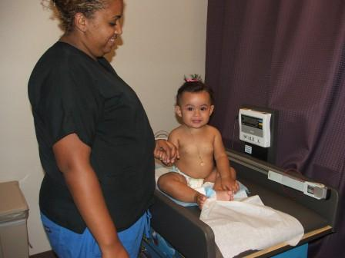
Weighing Infants & Toddlers
Up to 36 months if unable to stand without assistance
Notes:
Talking Points:
Weigh infant wearing only light underclothing or a clean, dry diaper.
Place infant in the center of the scale tray.
If using a beam scale, move lower weight from the zero until marker drops below the center point.
Weigh infant to nearest 10 gram or ½ oz
Record weight right away
If using beam balance, return upper and lower weights to zero

Slide 23
Weighing Infants & Toddlers
Weigh infant wearing only light underclothing
or a clean, dry diaper.
Place infant in the center of the scale tray.
If using a beam scale, move lower weight from the zero until marker drops below the center point.
Weigh infant to nearest 10 grams or ½ oz.
Record weight right away.
If using beam balance, return upper and lower weights to zero.

Slide 24
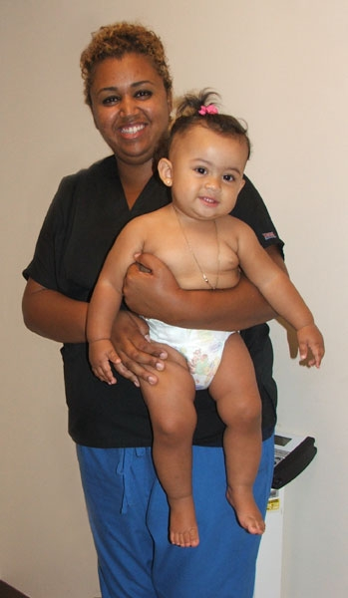
Alternate Weighing Method
Weigh parent and child together
= Total Weight
Weigh parent alone
Total Weight minus Parent’s Weight
= Child’s Weight
Notes:
Talking Points:
If a child is too scared or too squirmy to be weighed on his own, use this alternate weighing method. Or you may measure a child later in the appointment when they may be calmer.
Practice
Mother weighs 140 lbs
Mother holding infant weighs 156 lbs
What does the infant weigh?

Slide 25
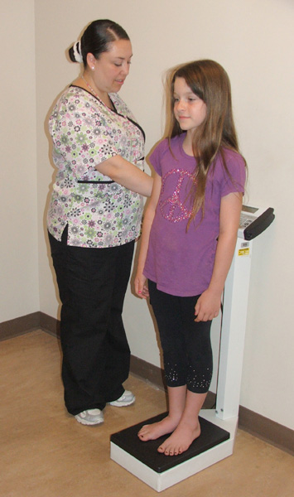
Weighing Children & Adolescents
Equipment Needed:
  Beam or electronic scale
  Weigh in 100 g or ¼ lb
  increments
  Large platform to support
  the child
  No length device attached
  No remote display with
  attachment cord

Slide 26
Weighing Children & Adolescents
Weigh in:
  Undergarments
  Gown
  Lightweight
  clothing
  Socks/bare feet
Notes:
Talking Points:
1. Remove bulky outer clothing (jackets and sweaters) and shoes, empty pockets of contents.
If diaper is used, be sure it is clean and dry.
2. Balance and zero the scale.
3. Have the child stand in the center of the scale, feet slightly apart.
4. Read the measurement to nearest 100 gram or ¼ lb
5. Record measurement right away.
Any combination of scarf hat, sweater, sweatshirt, coat, jacket can weigh up to 4 lbs. and shoes can add 2 pounds to a child’s weight.

Slide 27
Weighing Children & Adolescents
Remove bulky outer clothing (jackets and sweaters) and shoes. Empty pockets of contents. Use clean dry diaper.
Balance and zero the scale.
Have the child stand in the center of the scale, feet slightly apart.
Read the measurement to nearest 100 gram or ¼ lb.
Record the measurement right away.
Notes:
Any combination of scarf hat, sweater, sweatshirt, coat, jacket can weigh up to 4 lbs. and shoes can add up to 2 pounds to a child’s weight.

Slide 28
Additional
Growth Chart Training Modules
  http://depts.washington.edu/growth/
U.S. Department of Health and Human Services
Health Resources and Services Administration
(HRSA)
Maternal and Child Health Bureau
Notes:
Additional Growth Chart Training Modules

Slide 29
References
Health Resources and Services Administration (HRSA) is part of the U.S. Department of Health and Human Services and helps provide health resources for medically underserved populations. http://www.hrsa.gov/index.html
Photos with permission. Ventura County CHDP Program and Mandalay Bay Women and Children's Medical Group, August 19, 2011. Ventura County Health Care Agency. http://www.vchca.org/
Photo Credit
Notes:
Talking Points:
Here of references used in the development of this presentation.

Slide 30
Practice Time
Notes:
Talking Points:
Review:
1. Accurate weighing and measuring can help:
A) Identify growth problems
B) Determine if a child is underweight
C) Identify feeding problems
D) Provide feedback to parents on the health of their child
E) All of the above
2. How should the height of a healthy 3 yr old be taken?
A) Lying down
B) Standing up
3. Tell the person next to you one thing you will do to more accurately weigh and measure infants and children.
Background information:
Let’s practice standard technique on your equipment.
Have staff weigh and measure each other and a doll instead of an infant,(WIC usually has a doll you can borrow) and assess their technique and ability to read results.

